Slide 2
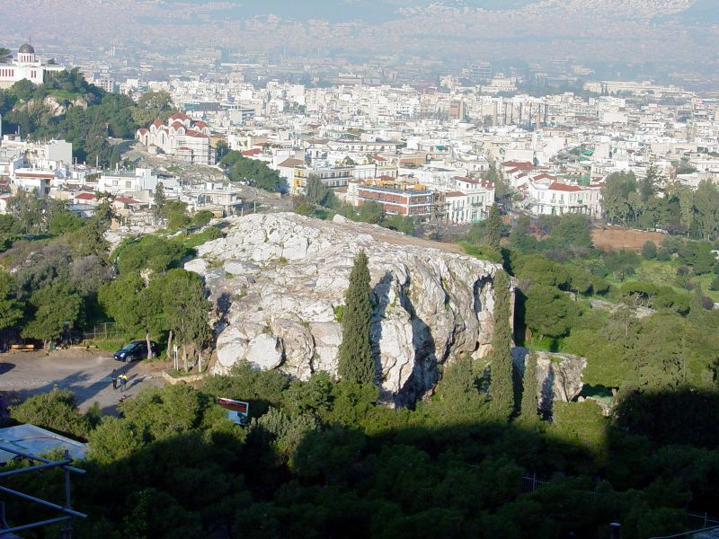

Slide 3
EPICUREANS
Epicurus 341 - 270 b.c.

Slide 4
EPICUREANS
Epicurus 341 - 270 b.c.
Pleasure is the answer

Slide 5
EPICUREANS
Epicurus 341 - 270 b.c.
Pleasure is the answer
Ideas of immortality disturbed men’s peace of mind, filled them w/ fear

Slide 6
EPICUREANS
Epicurus 341 - 270 b.c.
Pleasure is the answer
Ideas of immortality disturbed men’s peace of mind, filled them w/ fear
Atomic Theory – atoms made up the universe Atoms = physical Finer atoms = soul Still finer atoms = gods

Slide 7
EPICUREANS
Epicurus 341 - 270 b.c.
Pleasure is the answer
Ideas of immortality disturbed men’s peace of mind, filled them w/ fear
Atomic Theory – atoms made up the universe Atoms = physical Finer atoms = soul Still finer atoms = gods
End of Life = Ataraxia (imperturbability)

Slide 8
Stoics
Zeno 336 - 264 b.c. “Stoic” = painted porch

Slide 9
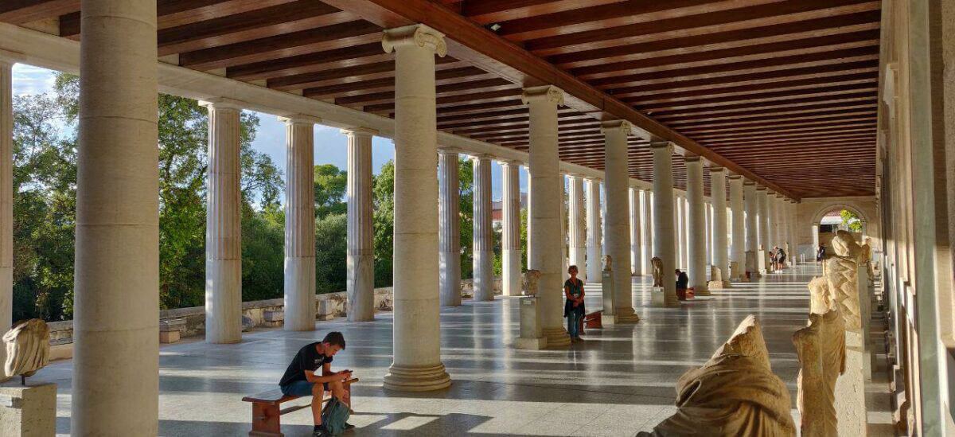

Slide 11
Stoics
Zeno 336 - 264 b.c. “Stoic” = painted porch
Follow Nature (reason)

Slide 12
Stoics
Zeno 336 - 264 b.c. “Stoic” = painted porch
Follow Nature (reason)
Good is found in the soul, not external

Slide 13
Stoics
Zeno 336 - 264 b.c. “Stoic” = painted porch
Follow Nature (reason)
Good is found in the soul, not external
Wisdom & restraint delivers one from the passions that perturb life

Slide 14
Stoics
Zeno 336 - 264 b.c. “Stoic” = painted porch
Follow Nature (reason)
Good is found in the soul, not external
Wisdom & restraint delivers one from the passions that perturb life
Passionless mastery of all emotions

Slide 15
Stoics
Zeno 336 - 264 b.c. “Stoic” = painted porch
Follow Nature (reason)
Good is found in the soul, not external
Wisdom & restraint delivers one from the passions that perturb life
Passionless mastery of all emotions
4 cardinal virtues: Wisdom Courage Justice Temperance

Slide 17
Acts 17:23
“The Unknown God”
Agnosto Theo

Slide 18
God made the world Doesn’t dwell in temples

Slide 19
God made the world Doesn’t dwell in temples
God gives life to all Doesn’t need anything

Slide 20
God made the world Doesn’t dwell in temples
God gives life to all Doesn’t need anything
God set boundaries / time So man will seek Him

Slide 21
God made the world Doesn’t dwell in temples
God gives life to all Doesn’t need anything
God set boundaries / time So man will seek Him
In God we live / move Not shaped by man

Slide 22
God made the world Doesn’t dwell in temples
God gives life to all Doesn’t need anything
God set boundaries / time So man will seek Him
In God we live / move Not shaped by man
God will judge world All men must repent

Slide 23
God made the world Doesn’t dwell in temples
God gives life to all Doesn’t need anything
God set boundaries / time So man will seek Him
In God we live / move Not shaped by man
God will judge world All men must repent
PROOF: GOD RAISED JESUS FROM THE DEAD

Slide 25
…these times of ignorance God overlooked, but now commands all men everywhere to repent

Slide 27
God who made the world and everything in it, Since He is Lord of heaven and earth, does not live in temples made with hands, nor is He worshiped with men’s hands, as though He needed anything, since He gives to all life, breath and all things. And He made from one blood every nation of men to dwell on all the face of the earth, and has determined their pre-appointed times and the boundaries of their habitation, so that they should seek the Lord, in the hope that they might grope for Him and find Him, though He is not far from from each one of us; for in Him we live and move and have our being, as also some of your own poets have said, ‘For we are also his offspring.’ Therefore since we are the offspring of God, we ought not to think that the Divine Nature is like gold or silver or stone, something shaped art and man’s devising. Truly these times of ignorance God overlooked, but now commands all men everywhere to repent, because He has appointed a day on which He will judge the world in righteousness by the Man whom He has ordained. He has given assurance of this to all by raising Him from the dead.

