Slide 1
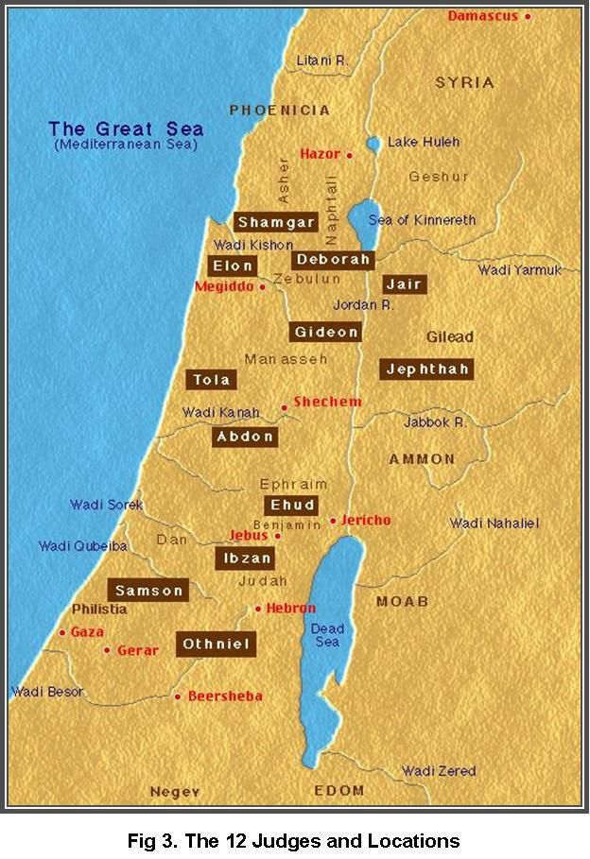
Tob
Jephthah
Ammon
Moab
Edom

