Slide 1
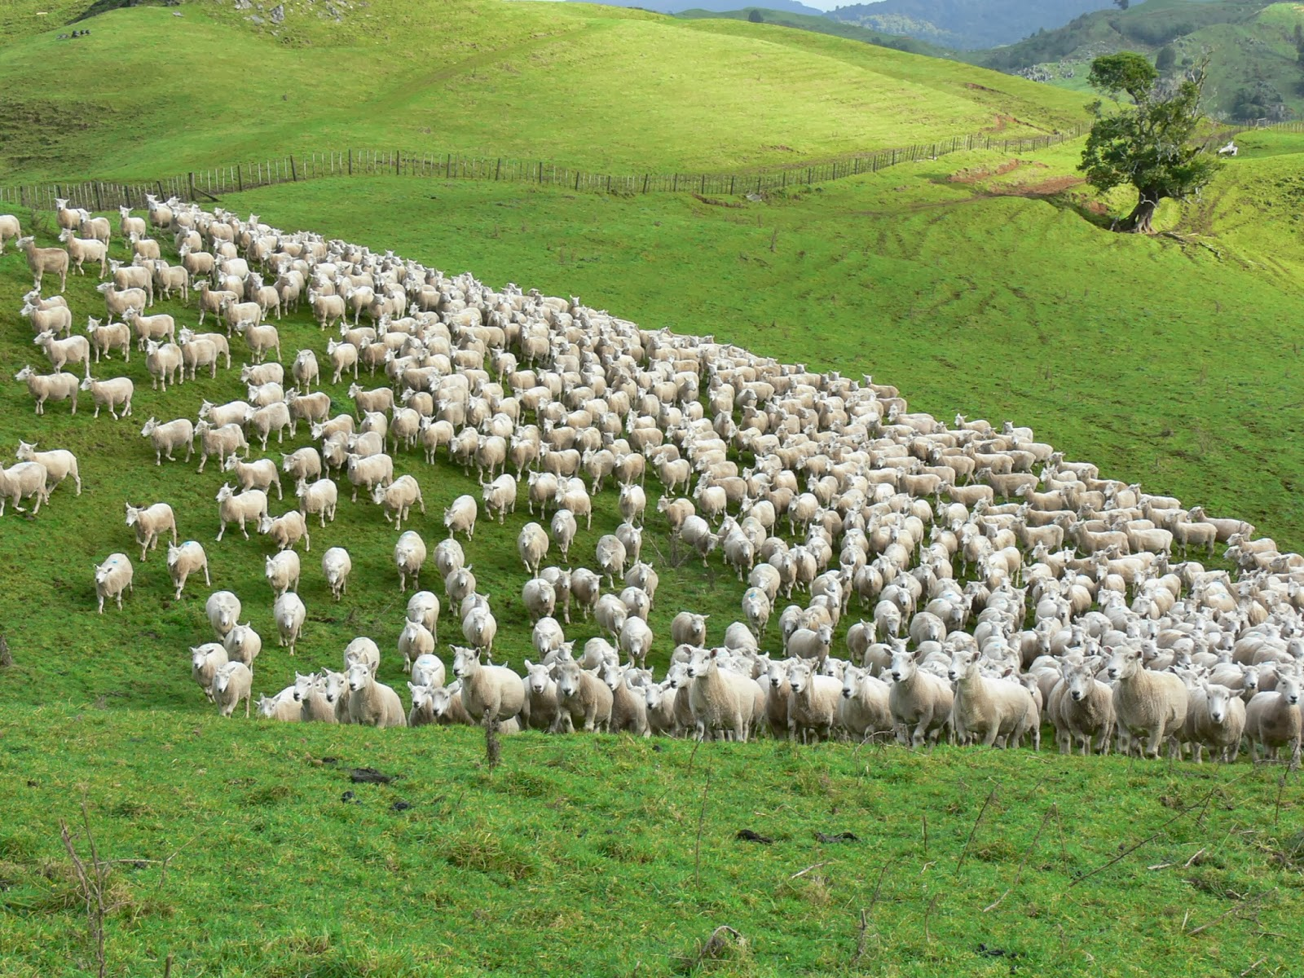

Slide 2
Elder
Pastor
Bishop

Slide 3
Elder
Pastor
Bishop
Holy Spirit has provided specific qualifications:
1 Timothy 3:1-7 Titus 1:6-9

Slide 4
ABILITY TO TEACH / RULE
CHARACTER
DOMESTIC RELATIONS
HABITS
REPUTATION
EXPERIENCE

Slide 5
CHARACTER
2. Sober-minded
3. Of Good Behavior/ Orderly
4. Given to Hospitality
5. Not Violent
6. No Striker
7. Gentle
8. Not Quarrelsome
9. Not Self-Willed
10. Just
11. Holy

Slide 6
CHARACTER
1. Not Arrogant
2. Sober-minded
3. Of Good Behavior/ Orderly
4. Given to Hospitality
5. Not Violent
6. No Striker
7. Gentle
8. Not Quarrelsome
9. Not Self-Willed
10. Just
11. Holy

Slide 7
CHARACTER
1. Not Arrogant
2. Sober-minded
3. Of Good Behavior/ Orderly
4. Given to Hospitality
5. Not Violent
6. No Striker
7. Gentle
8. Not Quarrelsome
9. Not Self-Willed
10. Just
11. Holy

Slide 8
CHARACTER
1. Not Arrogant
2. Sober-minded
3. Of Good Behavior/ Orderly
4. Given to Hospitality
5. Not Violent
6. No Striker
7. Gentle
8. Not Quarrelsome
9. Not Self-Willed
10. Just
11. Holy

Slide 9
CHARACTER
1. Not Arrogant
2. Sober-minded
3. Of Good Behavior/ Orderly
4. Given to Hospitality
5. Not Violent
6. No Striker
7. Gentle
8. Not Quarrelsome
9. Not Self-Willed
10. Just
11. Holy

Slide 10
CHARACTER
1. Not Arrogant
2. Sober-minded
3. Of Good Behavior/ Orderly
4. Given to Hospitality
5. Not Violent
6. No Striker
7. Gentle
8. Not Quarrelsome
9. Not Self-Willed
10. Just
11. Holy

Slide 11
CHARACTER
1. Not Arrogant
2. Sober-minded
3. Of Good Behavior/ Orderly
4. Given to Hospitality
5. Not Violent
6. No Striker
7. Gentle
8. Not Quarrelsome
9. Not Self-Willed
10. Just
11. Holy

Slide 12
ABILITY TO TEACH / RULE
CHARACTER
1. Not Arrogant
2. Sober-minded
3. Of Good Behavior/ Orderly
4. Given to Hospitality
5. Not Violent
6. No Striker
7. Gentle
8. Not Quarrelsome
9. Not Self-Willed
10. Just
11. Holy

Slide 13
ABILITY TO TEACH / RULE
1. Desire
CHARACTER
1. Not Arrogant
2. Sober-minded
3. Of Good Behavior/ Orderly
4. Given to Hospitality
5. Not Violent
6. No Striker
7. Gentle
8. Not Quarrelsome
9. Not Self-Willed
10. Just
11. Holy

Slide 14
ABILITY TO TEACH / RULE
1. Desire
2. Able to Teach
CHARACTER
1. Not Arrogant
2. Sober-minded
3. Of Good Behavior/ Orderly
4. Given to Hospitality
5. Not Violent
6. No Striker
7. Gentle
8. Not Quarrelsome
9. Not Self-Willed
10. Just
11. Holy

Slide 15
ABILITY TO TEACH / RULE
1. Desire
2. Able to Teach
3. Holding Fast the Faithful ….Word
CHARACTER
1. Not Arrogant
2. Sober-minded
3. Of Good Behavior/ Orderly
4. Given to Hospitality
5. Not Violent
6. No Striker
7. Gentle
8. Not Quarrelsome
9. Not Self-Willed
10. Just
11. Holy

Slide 16
ABILITY TO TEACH / RULE
1. Desire
2. Able to Teach
3. Holding Fast the Faithful ….Word
4. Able to Exhort / Instruct ….iin sound Doctrine
CHARACTER
1. Not Arrogant
2. Sober-minded
3. Of Good Behavior/ Orderly
4. Given to Hospitality
5. Not Violent
6. No Striker
7. Gentle
8. Not Quarrelsome
9. Not Self-Willed
10. Just
11. Holy

Slide 17
ABILITY TO TEACH / RULE
1. Desire
2. Able to Teach
3. Holding Fast the Faithful ….Word
4. Able to Exhort / Instruct ….iin sound Doctrine
5. Able to Rebuke /Convict ….those who contradict
CHARACTER
1. Not Arrogant
2. Sober-minded
3. Of Good Behavior/ Orderly
4. Given to Hospitality
5. Not Violent
6. No Striker
7. Gentle
8. Not Quarrelsome
9. Not Self-Willed
10. Just
11. Holy

Slide 18
ABILITY TO TEACH / RULE
1. Desire
2. Able to Teach
3. Holding Fast the Faithful ….Word
4. Able to Exhort / Instruct ….iin sound Doctrine
5. Able to Rebuke /Convict ….those who contradict
CHARACTER
1. Not Arrogant
2. Sober-minded
3. Of Good Behavior/ Orderly
4. Given to Hospitality
5. Not Violent
6. No Striker
7. Gentle
8. Not Quarrelsome
9. Not Self-Willed
10. Just
11. Holy
DOMESTIC RELATIONS
2. Husband of One Wife
3. Rules Own House Well
4. Children in Subjection
5. Having Believing Children ( …not Accused
of Riot / Unruly

Slide 19
ABILITY TO TEACH / RULE
1. Desire
2. Able to Teach
3. Holding Fast the Faithful ….Word
4. Able to Exhort / Instruct ….iin sound Doctrine
5. Able to Rebuke /Convict ….those who contradict
CHARACTER
1. Not Arrogant
2. Sober-minded
3. Of Good Behavior/ Orderly
4. Given to Hospitality
5. Not Violent
6. No Striker
7. Gentle
8. Not Quarrelsome
9. Not Self-Willed
10. Just
11. Holy
DOMESTIC RELATIONS
1. A Man
2. Husband of One Wife
3. Rules Own House Well
4. Children in Subjection
5. Having Believing Children ( …not Accused
of Riot / Unruly

Slide 20
ABILITY TO TEACH / RULE
1. Desire
2. Able to Teach
3. Holding Fast the Faithful ….Word
4. Able to Exhort / Instruct ….iin sound Doctrine
5. Able to Rebuke /Convict ….those who contradict
CHARACTER
1. Not Arrogant
2. Sober-minded
3. Of Good Behavior/ Orderly
4. Given to Hospitality
5. Not Violent
6. No Striker
7. Gentle
8. Not Quarrelsome
9. Not Self-Willed
10. Just
11. Holy
DOMESTIC RELATIONS
1. A Man
2. Husband of One Wife
3. Rules Own House Well
4. Children in Subjection
5. Having Believing Children ( …not Accused
of Riot / Unruly

Slide 21
ABILITY TO TEACH / RULE
1. Desire
2. Able to Teach
3. Holding Fast the Faithful ….Word
4. Able to Exhort / Instruct ….iin sound Doctrine
5. Able to Rebuke /Convict ….those who contradict
CHARACTER
1. Not Arrogant
2. Sober-minded
3. Of Good Behavior/ Orderly
4. Given to Hospitality
5. Not Violent
6. No Striker
7. Gentle
8. Not Quarrelsome
9. Not Self-Willed
10. Just
11. Holy
DOMESTIC RELATIONS
1. A Man
2. Husband of One Wife
3. Rules Own House Well
4. Children in Subjection
5. Having Believing Children ( …not Accused
of Riot / Unruly

Slide 22
ABILITY TO TEACH / RULE
1. Desire
2. Able to Teach
3. Holding Fast the Faithful ….Word
4. Able to Exhort / Instruct ….iin sound Doctrine
5. Able to Rebuke /Convict ….those who contradict
CHARACTER
1. Not Arrogant
2. Sober-minded
3. Of Good Behavior/ Orderly
4. Given to Hospitality
5. Not Violent
6. No Striker
7. Gentle
8. Not Quarrelsome
9. Not Self-Willed
10. Just
11. Holy
DOMESTIC RELATIONS
1. A Man
2. Husband of One Wife
3. Rules Own House Well
4. Children in Subjection
5. Having Believing Children ( …not Accused
of Riot / Unruly
REPUTATION
2. Without Reproach / Blameless
3
. Not Covetous

Slide 23
ABILITY TO TEACH / RULE
1. Desire
2. Able to Teach
3. Holding Fast the Faithful ….Word
4. Able to Exhort / Instruct ….iin sound Doctrine
5. Able to Rebuke /Convict ….those who contradict
CHARACTER
1. Not Arrogant
2. Sober-minded
3. Of Good Behavior/ Orderly
4. Given to Hospitality
5. Not Violent
6. No Striker
7. Gentle
8. Not Quarrelsome
9. Not Self-Willed
10. Just
11. Holy
DOMESTIC RELATIONS
1. A Man
2. Husband of One Wife
3. Rules Own House Well
4. Children in Subjection
5. Having Believing Children ( …not Accused
of Riot / Unruly
REPUTATION
1. Good Testimony from Without
2. Without Reproach / Blameless
3. Not Covetous

Slide 24
ABILITY TO TEACH / RULE
1. Desire
2. Able to Teach
3. Holding Fast the Faithful ….Word
4. Able to Exhort / Instruct ….iin sound Doctrine
5. Able to Rebuke /Convict ….those who contradict
CHARACTER
1. Not Arrogant
2. Sober-minded
3. Of Good Behavior/ Orderly
4. Given to Hospitality
5. Not Violent
6. No Striker
7. Gentle
8. Not Quarrelsome
9. Not Self-Willed
10. Just
11. Holy
DOMESTIC RELATIONS
1. A Man
2. Husband of One Wife
3. Rules Own House Well
4. Children in Subjection
5. Having Believing Children ( …not Accused
of Riot / Unruly
REPUTATION
1. Good Testimony from Without
2. Without Reproach / Blameless
3. Not Covetous

Slide 25
ABILITY TO TEACH / RULE
1. Desire
2. Able to Teach
3. Holding Fast the Faithful ….Word
4. Able to Exhort / Instruct ….iin sound Doctrine
5. Able to Rebuke /Convict ….those who contradict
CHARACTER
1. Not Arrogant
2. Sober-minded
3. Of Good Behavior/ Orderly
4. Given to Hospitality
5. Not Violent
6. No Striker
7. Gentle
8. Not Quarrelsome
9. Not Self-Willed
10. Just
11. Holy
DOMESTIC RELATIONS
1. A Man
2. Husband of One Wife
3. Rules Own House Well
4. Children in Subjection
5. Having Believing Children ( …not Accused
of Riot / Unruly
REPUTATION
1. Good Testimony from Without
2. Without Reproach / Blameless
3. Not Covetous

Slide 26
ABILITY TO TEACH / RULE
1. Desire
2. Able to Teach
3. Holding Fast the Faithful ….Word
4. Able to Exhort / Instruct ….iin sound Doctrine
5. Able to Rebuke /Convict ….those who contradict
CHARACTER
1. Not Arrogant
2. Sober-minded
3. Of Good Behavior/ Orderly
4. Given to Hospitality
5. Not Violent
6. No Striker
7. Gentle
8. Not Quarrelsome
9. Not Self-Willed
10. Just
11. Holy
DOMESTIC RELATIONS
1. A Man
2. Husband of One Wife
3. Rules Own House Well
4. Children in Subjection
5. Having Believing Children ( …not Accused
of Riot / Unruly
HABITS
2. Not Quick-Tempered
3. Not Given to Wine
4. No Brawler
5. Not Greedy for Money
REPUTATION
1. Good Testimony from Without
2. Without Reproach / Blameless
3. Not Covetous

Slide 27
ABILITY TO TEACH / RULE
1. Desire
2. Able to Teach
3. Holding Fast the Faithful ….Word
4. Able to Exhort / Instruct ….iin sound Doctrine
5. Able to Rebuke /Convict ….those who contradict
CHARACTER
1. Not Arrogant
2. Sober-minded
3. Of Good Behavior/ Orderly
4. Given to Hospitality
5. Not Violent
6. No Striker
7. Gentle
8. Not Quarrelsome
9. Not Self-Willed
10. Just
11. Holy
DOMESTIC RELATIONS
1. A Man
2. Husband of One Wife
3. Rules Own House Well
4. Children in Subjection
5. Having Believing Children ( …not Accused
of Riot / Unruly
HABITS
1. Self-controlled
2. Not Quick-Tempered
3. Not Given to Wine
4. No Brawler
5. Not Greedy for Money
REPUTATION
1. Good Testimony from Without
2. Without Reproach / Blameless
3. Not Covetous

Slide 28
ABILITY TO TEACH / RULE
1. Desire
2. Able to Teach
3. Holding Fast the Faithful ….Word
4. Able to Exhort / Instruct ….iin sound Doctrine
5. Able to Rebuke /Convict ….those who contradict
CHARACTER
1. Not Arrogant
2. Sober-minded
3. Of Good Behavior/ Orderly
4. Given to Hospitality
5. Not Violent
6. No Striker
7. Gentle
8. Not Quarrelsome
9. Not Self-Willed
10. Just
11. Holy
DOMESTIC RELATIONS
1. A Man
2. Husband of One Wife
3. Rules Own House Well
4. Children in Subjection
5. Having Believing Children ( …not Accused
of Riot / Unruly
HABITS
1. Self-controlled
2. Not Quick-Tempered
3. Not Given to Wine
4. No Brawler
5. Not Greedy for Money
REPUTATION
1. Good Testimony from Without
2. Without Reproach / Blameless
3. Not Covetous

Slide 29
ABILITY TO TEACH / RULE
1. Desire
2. Able to Teach
3. Holding Fast the Faithful ….Word
4. Able to Exhort / Instruct ….iin sound Doctrine
5. Able to Rebuke /Convict ….those who contradict
CHARACTER
1. Not Arrogant
2. Sober-minded
3. Of Good Behavior/ Orderly
4. Given to Hospitality
5. Not Violent
6. No Striker
7. Gentle
8. Not Quarrelsome
9. Not Self-Willed
10. Just
11. Holy
DOMESTIC RELATIONS
1. A Man
2. Husband of One Wife
3. Rules Own House Well
4. Children in Subjection
5. Having Believing Children ( …not Accused
of Riot / Unruly
HABITS
1. Self-controlled
2. Not Quick-Tempered
3. Not Given to Wine
4. No Brawler
5. Not Greedy for Money
REPUTATION
1. Good Testimony from Without
2. Without Reproach / Blameless
3. Not Covetous

Slide 30
ABILITY TO TEACH / RULE
1. Desire
2. Able to Teach
3. Holding Fast the Faithful ….Word
4. Able to Exhort / Instruct ….iin sound Doctrine
5. Able to Rebuke /Convict ….those who contradict
CHARACTER
1. Not Arrogant
2. Sober-minded
3. Of Good Behavior/ Orderly
4. Given to Hospitality
5. Not Violent
6. No Striker
7. Gentle
8. Not Quarrelsome
9. Not Self-Willed
10. Just
11. Holy
DOMESTIC RELATIONS
1. A Man
2. Husband of One Wife
3. Rules Own House Well
4. Children in Subjection
5. Having Believing Children ( …not Accused
of Riot / Unruly
HABITS
1. Self-controlled
2. Not Quick-Tempered
3. Not Given to Wine
4. No Brawler
5. Not Greedy for Money
REPUTATION
1. Good Testimony from Without
2. Without Reproach / Blameless
3. Not Covetous

Slide 31
ABILITY TO TEACH / RULE
1. Desire
2. Able to Teach
3. Holding Fast the Faithful ….Word
4. Able to Exhort / Instruct ….iin sound Doctrine
5. Able to Rebuke /Convict ….those who contradict
CHARACTER
1. Not Arrogant
2. Sober-minded
3. Of Good Behavior/ Orderly
4. Given to Hospitality
5. Not Violent
6. No Striker
7. Gentle
8. Not Quarrelsome
9. Not Self-Willed
10. Just
11. Holy
DOMESTIC RELATIONS
1. A Man
2. Husband of One Wife
3. Rules Own House Well
4. Children in Subjection
5. Having Believing Children ( …not Accused
of Riot / Unruly
HABITS
1. Self-controlled
2. Not Quick-Tempered
3. Not Given to Wine
4. No Brawler
5. Not Greedy for Money
REPUTATION
1. Good Testimony from Without
2. Without Reproach / Blameless
3. Not Covetous

Slide 32
ABILITY TO TEACH / RULE
1. Desire
2. Able to Teach
3. Holding Fast the Faithful ….Word
4. Able to Exhort / Instruct ….iin sound Doctrine
5. Able to Rebuke /Convict ….those who contradict
CHARACTER
1. Not Arrogant
2. Sober-minded
3. Of Good Behavior/ Orderly
4. Given to Hospitality
5. Not Violent
6. No Striker
7. Gentle
8. Not Quarrelsome
9. Not Self-Willed
10. Just
11. Holy
DOMESTIC RELATIONS
1. A Man
2. Husband of One Wife
3. Rules Own House Well
4. Children in Subjection
5. Having Believing Children ( …not Accused
of Riot / Unruly
HABITS
1. Self-controlled
2. Not Quick-Tempered
3. Not Given to Wine
4. No Brawler
5. Not Greedy for Money
REPUTATION
1. Good Testimony from Without
2. Without Reproach / Blameless
3. Not Covetous
EXPERIENCE
1. Not a Novice

Slide 33
1 Timothy 3:11
“Likewise their wives must be:

Slide 34
1 Timothy 3:11
“Likewise their wives must be:
Reverent (dignified),

Slide 35
1 Timothy 3:11
“Likewise their wives must be:
Reverent (dignified),
Not slanderers (malicious gossips),

Slide 36
1 Timothy 3:11
“Likewise their wives must be:
Reverent (dignified),
Not slanderers (malicious gossips),
Temperate (sober-minded),

Slide 37
1 Timothy 3:11
“Likewise their wives must be:
Reverent (dignified),
Not slanderers (malicious gossips),
Temperate (sober-minded),
Faithful in all things.”

Slide 38
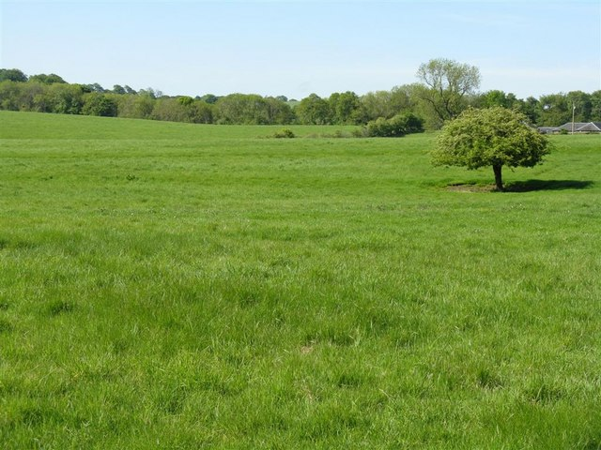
An elder/bishop/pastor is a man who through experience and time has demonstrated the qualities of character to effectively lead, feed and protect the children of God. This man will have the scriptural knowledge and ability to stand against and turn back any effort to undermine the congregation - whether from within the flock or without.

Slide 39
These qualifications point to a man of:
Spiritual Wisdom

Slide 40
These qualifications point to a man of:
Spiritual Wisdom
Emotional Maturity

Slide 41
These qualifications point to a man of:
Spiritual Wisdom
Emotional Maturity
Good Judgment

Slide 42
These qualifications point to a man of:
Spiritual Wisdom
Emotional Maturity
Good Judgment
Consistent Leadership

Slide 43
These qualifications point to a man of:
Spiritual Wisdom
Emotional Maturity
Good Judgment
Consistent Leadership
Unquestioned Sincerity

Slide 44
These qualifications point to a man of:
Spiritual Wisdom
Emotional Maturity
Good Judgment
Consistent Leadership
Unquestioned Sincerity
Uncompromising Integrity

Slide 45
These qualifications point to a man of:
Spiritual Wisdom
Emotional Maturity
Good Judgment
Consistent Leadership
Unquestioned Sincerity
Uncompromising Integrity
… In other words….

Slide 46
Someone you can confidently
trust your eternal soul with.

