Slide 2
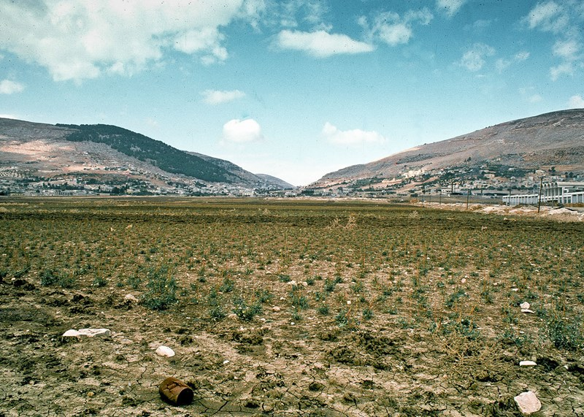
Valley of
Shechem
This Photo by Unknown Author is licensed under CC BY-SA

Slide 3
Mt. Gerizim
Mt. Ebal
Valley of
Shechem
This Photo by Unknown Author is licensed under CC BY-SA

Slide 4
Deuteronomy 28
Mt. Gerizim
Mt. Ebal
Valley of
Shechem
This Photo by Unknown Author is licensed under CC BY-SA

Slide 5
Deuteronomy 28
Mt. Gerizim
Mt. Ebal
Simeon
Levi
Judah
Issachar
Joseph
Benjamin
Reuben
Gad
Asher
Zebulun
Dan
Naphtali
Valley of
Shechem
This Photo by Unknown Author is licensed under CC BY-SA

Slide 6
Deut 28:1-14 – Blessings
“…these blessings shall
overtake you, because you obey the voice of the Lord your God…the Lord shall establish you as a holy people to Himself…The Lord will open to you His good treasure…if you heed the commandments of Lord”

Slide 7
Deut 28:1-14 – Blessings
“…these blessings shall
overtake you, because you obey the voice of the Lord your God…the Lord shall establish you as a holy people to Himself…The Lord will open to you His good treasure…if you heed the commandments of Lord”
Deut 28:15-68 - Cursing
“…you shall become troublesome to all the kingdoms of the earth… you shall become an astonishment, a proverb,
a byword among the nations. They, shall be upon you for a sign and a wonder, and on your descendants forever.”

Slide 8
Nation of Israel
Entered the
Promised Land
Feared
by all nations

Slide 9
Nation of Israel
Entered the
Promised Land
Feared
by all nations
Kingdom Divided
Drawn away from God to worship pagan idols…
REPEATEDLY…
Generation
after
Generation

Slide 10
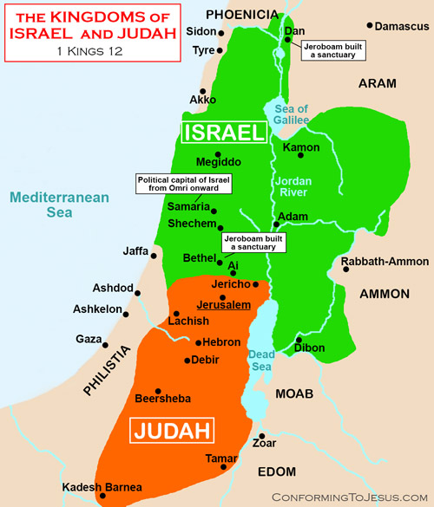
Kingdom divided:
Kingdom of Israel
10 northern tribes
Kingdom of Judah
Judah
Benjamin
ISRAEL
JUDAH

Slide 11
Kingdom divided:
Kingdom of Israel
10 northern tribes
Kingdom of Judah
Judah
Benjamin
Kingdom of Israel
taken captive by Assyrians
722 b.c.
2 Kings 17:23
Total annihilation
Assyria = Iran

Slide 12
Assyria
( Iran )
JUDAH

Slide 13
Assyrians repatriated Israel 2 Kings 17:24
“Then the king of Assyria brought people from Babylon, Cuthah (Iraq), Ava (Assyrian), Hamath and from Sepharvaim (Syrian), and placed them in the cities of Samaria instead of the children of Israel; and they took possession of Samaria and dwelt in its cities.”

Slide 14
Assyria
Babylon Iraq
Assyria Syria
JUDAH

Slide 15
Kingdom divided:
Kingdom of Israel
10 northern tribes
Kingdom of Judah
Judah
Benjamin
Kingdom of Judah
captured by
Babylonians
606 b.c.
Jeremiah 25
Held Captive
70 years
Returned 536 b.c.

Slide 16
Babylonians will capture Judah Jeremiah 25:9-11
“Behold I will send…Nebuchadnezzar the king of Babylon…against this land…will utterly destroy them and make them a astonishment, a hissing, and perpetual desolations…this whole land shall be a desolation and an astonishment, and these nations shall serve the king of Babylon seventy years.”

Slide 17
Babylon Iraq
Assyria Syria
606 b.c.
Babylonia
Remnant of Jews
return
JUDAH
536 b.c.

Slide 18
Kingdom of Judah
captured by
Babylonians
606 b.c.
70 years later
536 b.c. – 30 A.D.
Failed to honor
God

Slide 19
Kingdom of Judah
captured by
Babylonians
606 b.c.
70 years later
536 b.c. – 30 A.D.
Failed to honor
God
Kingdom of Judah
Jerusalem
Temple
Records
Totally Destroyed
70 A.D.
Matt 24, Mk 13,
Luke 21

Slide 20
Why the continued hatred of “Jews?”

Slide 21
“And you shall become an astonishment (a thing of horror), a proverb, and a byword among all the nations where the Lord will drive you.
And they (these curses) shall be upon you for a sign and a wonder, and on your descendants forever.”
- Deuteronomy 28:37, 46

Slide 22
So who is a real Jew?
“For he is not a Jew who is one outwardly, nor is that circumcision which is outward in the flesh;
but he is a Jew who is one inwardly, and the circumcision is that of the heart, in the Spirit (New law), and not in the letter (Old law), whose praise (Jew = praise) is not from men but from God.”
- Romans 2:28,29

