Slide 1
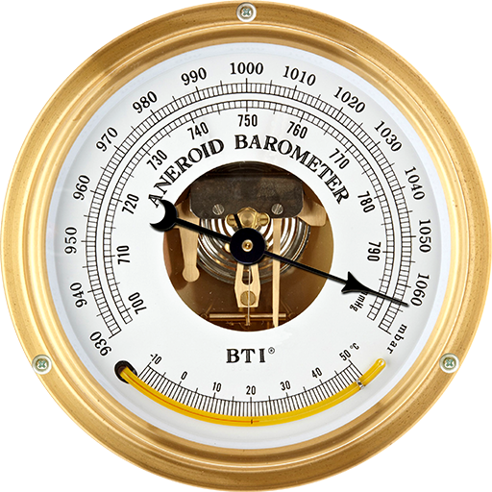
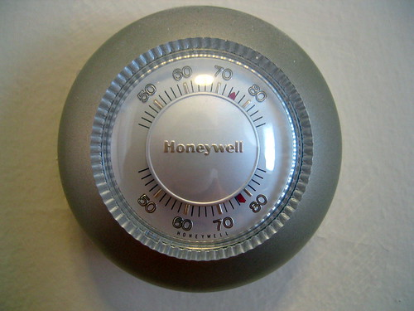

Slide 3
Conscience is the barometer of a person’s soul

Slide 4
Conscience = Sense of moral goodness, one’s character
guided by feeling of obligation to do right

Slide 5
Rom 2:14,15
When Gentiles, who do not have the Law, by nature do the things contained in the Law, these…are a law unto themselves, show the work of the law written in their hearts, their conscience bearing witness…accusing or excusing them.

Slide 6
Rom 1:24
God gave them up to
uncleanness…
Rom 1:26
God gave them up to vile
passions…
Rom 1:28
God gave them over to a
debased mind
Rom 2:14,15
When Gentiles, who do not have the Law, by nature do the things contained in the Law, these…are a law unto themselves, show the work of the law written in their hearts, their conscience bearing witness…accusing or excusing them.

Slide 7
1 Tim 4:1-3 – Our conscience can be seared

Slide 8
1 Tim 4:1-3 – Our conscience can be seared
Rom 1:18 – who suppress the truth in unrighteousness

Slide 9
1 Tim 4:1-3 – Our conscience can be seared
Rom 1:18 – who suppress the truth in unrighteousness
Eph 4:17-19 – people’s understanding can be darkened,
alienated from God, made ignorant, hardened past feeling, given to licentiousness, to work all
uncleanness with greediness

Slide 10
Does having a good conscience make us right?

Slide 11
Does having a good conscience make us right?
Acts 23:1 – “I have lived in all good conscience
before God until this day.”

Slide 12
Definition of a mature faith – Hebrews 5:13,14
Those who exercise (use) their senses
to discern between good and evil

Slide 13
It could be…
Conscience is the thermometer
of a person’s soul

Slide 14
We need our conscience healthy
to warn us against ungodliness
What defines “healthy?”

Slide 15
We need our conscience healthy
to warn us against ungodliness
What defines “healthy?”
Healthy = Godly

Slide 16
How Godly is our conscience?

