Slide 2
Perfect = gk. TELEIOS = complete, mature, having
reached it’s end, full-grown

Slide 3
Perfect = gk. TELEIOS = complete, mature, having
reached it’s end, full-grown
Never in the New Testament does the word “Perfect” mean SINLESS

Slide 5
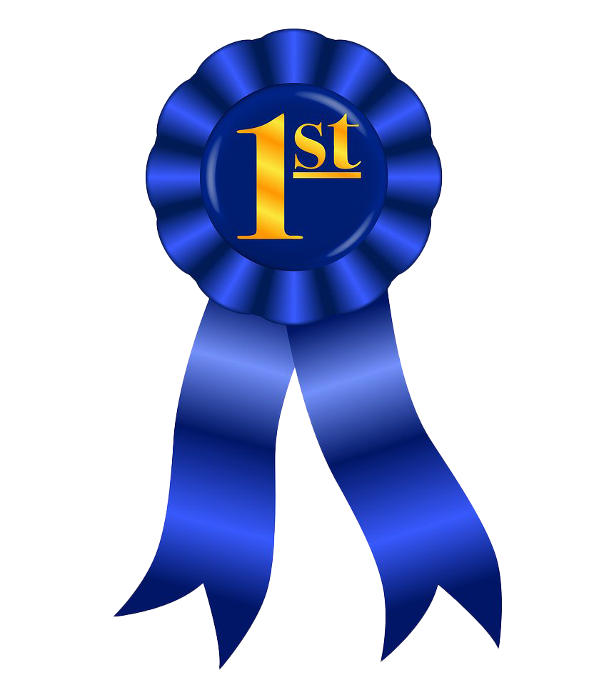

Slide 7
* spoiled berries
* old flour
* over-cooked

Slide 8
Which pie is perfect?
* spoiled berries
* old flour
* over-cooked

Slide 9
Which pie is perfect?
* spoiled berries
* old flour
* over-cooked

Slide 10
MATTHEW 19:20,21
“…All these I have kept from my youth. What do I still lack ? And Jesus said to him, if you want to be PERFECT, go, sell what you have and give to the poor and you will have treasure in heaven…”

Slide 11
Philippians 3:12-15
I have not attained, or been perfected (teleios)
But I press on to lay hold of that (resurrection)…

Slide 12
Philippians 3:12-15
I have not attained, or been perfected (teleios)
But I press on to lay hold of that (resurrection)…
I have not laid hold of it (the resurrection from dead)
But one thing I do:
FORGET – the things behind me
REACH – to the things ahead of me
PRESS – toward the goal…prize of the call of God

Slide 13
Philippians 3:12-15
I have not attained, or been PERFECTED (teleios)
But I press on to lay hold of that (resurrection)…
I have not laid hold of it (the resurrection from dead)
But one thing I do:
FORGET – the things behind me
REACH – to the things ahead of me
PRESS – toward the goal…prize of the call of God
Therefore…as many as are PERFECT , have this mind

Slide 14
Philippians 3:12-15
I have not attained, or been PERFECTED (teleios)
But I press on to lay hold of that (resurrection)…
I have not laid hold of it (the resurrection from dead)
But one thing I do:
FORGET – the things behind me
REACH – to the things ahead of me
PRESS – toward the goal…prize of the call of God
Therefore…as many as are PERFECT , have this mind

Slide 15
PERFECT :
Teleioo (verb) – to bring to an end by completing or perfecting, accomplish (finish, fulfil)

Slide 16
PERFECT :
Teleioo (verb) – to bring to an end by completing or perfecting, accomplish (finish, fulfil)
“…that He, by the grace of God, might taste death for everyone. For it was fitting for Him…to make the author of their salvation perfect through sufferings.”
- Hebrews 2:9,10

Slide 17
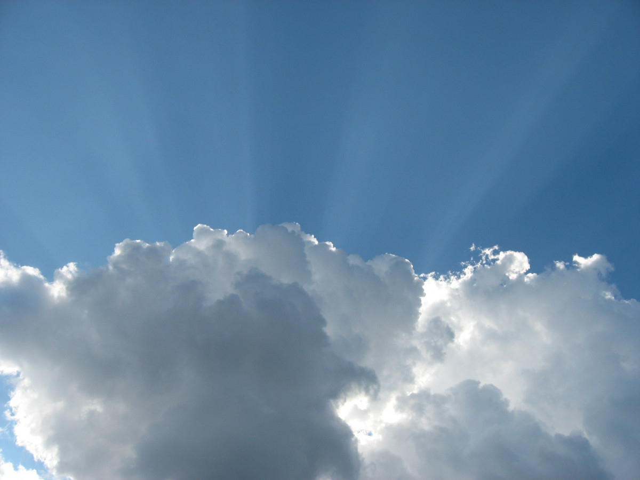
That I might know HIM,
the power of His resurrection,
the fellowship of His suffering
being conformed to His death…
- Philippians 3:10,11

Slide 18
The power of His resurrection

