Slide 2
Time

Slide 3
Creation
Time
Destruction

Slide 4
G O D
Creation
Time
Destruction

Slide 5
G O D
Time

Slide 6
G O D

Slide 7
Jesus says:
“God is Spirit, and those who worship Him must worship Him in spirit and truth.”
John 4:24

Slide 8
Exodus 3:13,14
Moses asks the Lord: Who do I say you are?

Slide 9
Exodus 3:13,14
Moses asks the Lord: Who do I say you are?
God responds: I AM WHO I AM
Havah = Exist, Be

Slide 10
Power
Knowledge
Wisdom
Love
Grace
Patience
Goodness

Slide 11
Power
Knowledge
Wisdom
Love
Grace
Patience
Goodness
Not that God
HAS these, but…
GOD IS these things

Slide 12
Power
Knowledge
Wisdom
Love
Grace
Patience
Goodness
Not that God
HAS these, but…
GOD IS these things
All the positive realities of life are from God

Slide 13
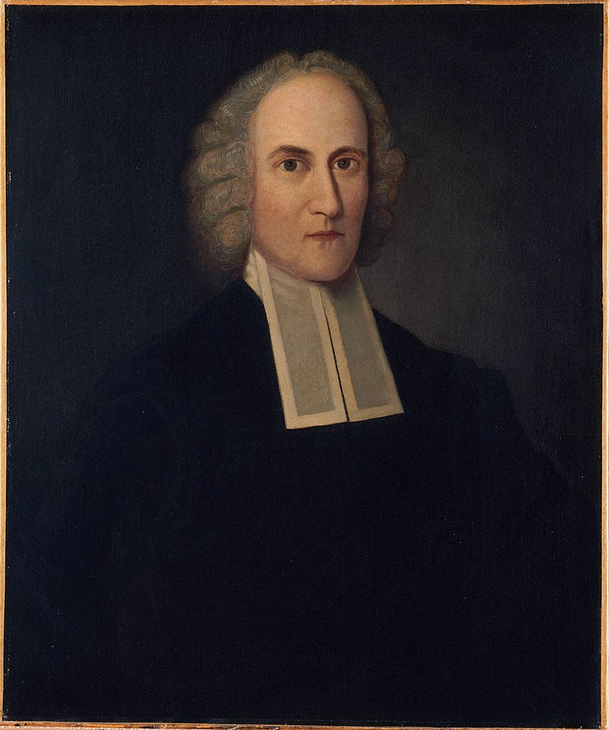
Jonathan Edwards
1703 - 1758

Slide 14
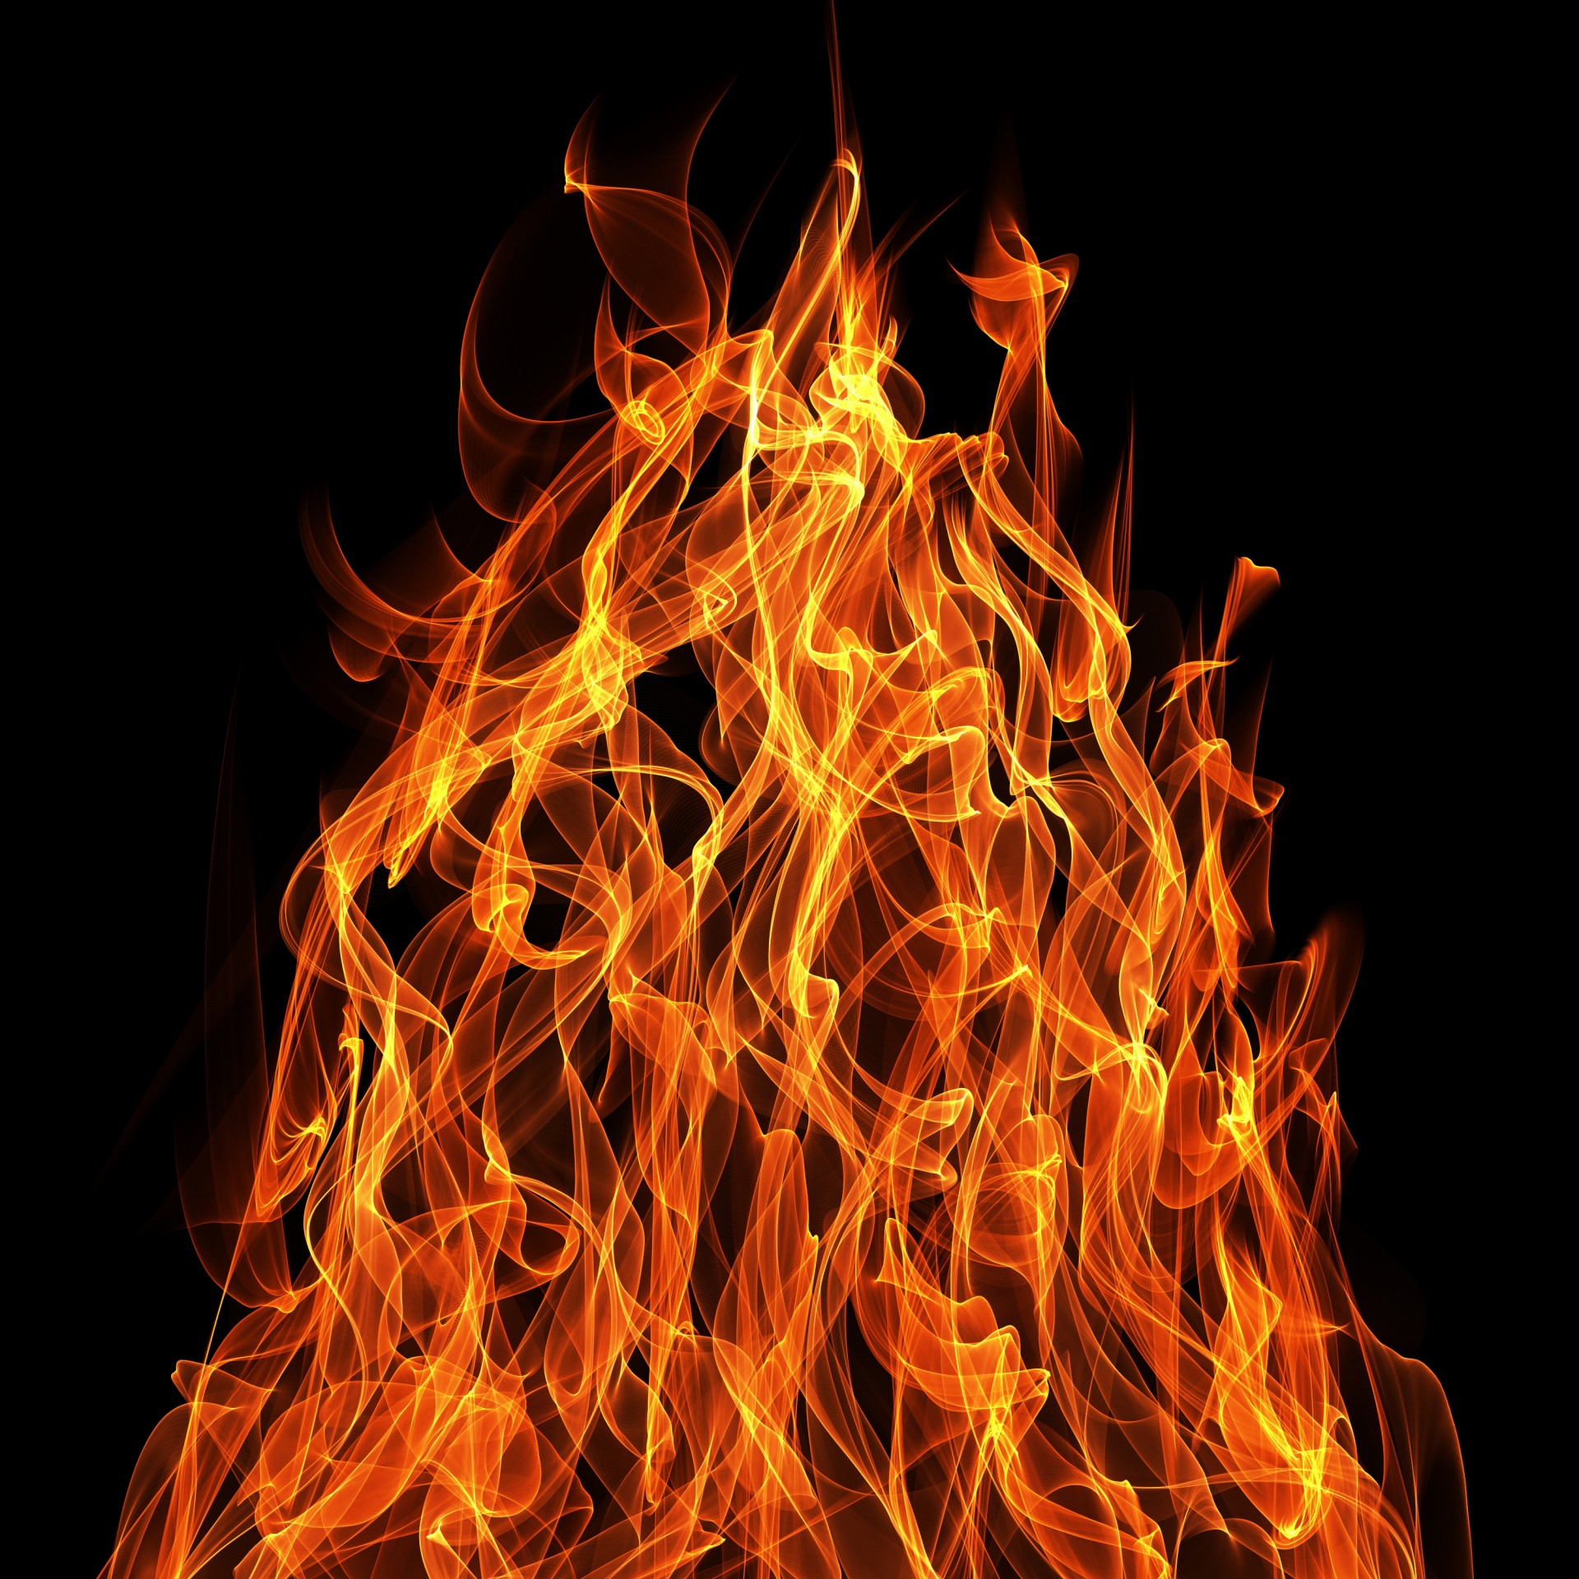
SINNERS IN THE HANDS OF AN ANGRY GOD
Deuteronomy 32:35
“Their foot shall slip in due time, for the day of their calamity is at hand.”

Slide 15
SINNERS IN THE HANDS OF AN ANGRY GOD
“There is nothing that keeps wicked men at any one
moment out of hell but the mere pleasure of God.”
“The devil stands ready to fall upon them and seize them as his own, as what moment God shall permit.”

Slide 16
The Lord…is not willing that any should perish but that all should come to repentance
2 Peter 3:9

Slide 17
Exodus 33:12-19
Moses says to the Lord: Show me who you are

Slide 18
Exodus 33:12-19
Moses says to the Lord: Show me who you are
Lord answers in Exodus 34:5-7

Slide 19
Exodus 33:12-19
Moses says to the Lord: Show me who you are
Lord answers in Exodus 34:5-7
“…The Lord, the Lord God, merciful and gracious, longsuffering, and abounding in goodness and truth, keeping mercy for thousands, forgiving iniquity and transgression and sin, by no means clearing the guilty…”

Slide 20
Exodus 34:5-7
“…forgiving iniquity and transgression and sin, by no means clearing the guilty, visiting the iniquities of the father upon the children and the children’s children to the third and fourth generation.”
Visiting = consequences, not guilt

Slide 21
EZEKIEL 18
The word of the Lord comes to Ezekiel to refute the idea that a child will suffer the guilt of the father’s sin

Slide 22
EZEKIEL 18
Story of 3 Generations:
Righteous father …He is just, he shall surely live
Wicked son …he shall surely die
Righteous grandson …he shall surely live

Slide 23
EZEKIEL 18
18:20 – “The soul who sins shall die. The son shall not bear the guilt of the father, nor the father bear the guilt of the son…”
18:23 – “Do I have any pleasure at all that the wicked should die?”
18:32 – “For I have no pleasure in the death of one who dies.”

Slide 24
EZEKIEL 33
33:11 – “As I live, says the Lord God, I have no pleasure in the death of the wicked, but that the wicked turn from his way and live. Turn, turn from your evil ways! For why should you die, O house of Israel?”

Slide 25
The Lord…is not willing that any should perish but that all should come to repentance
2 Peter 3:9

